Slide 1

N-Puzzle with AI
Name: Hoang Do
Will Awad

Slide 2

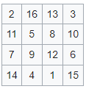
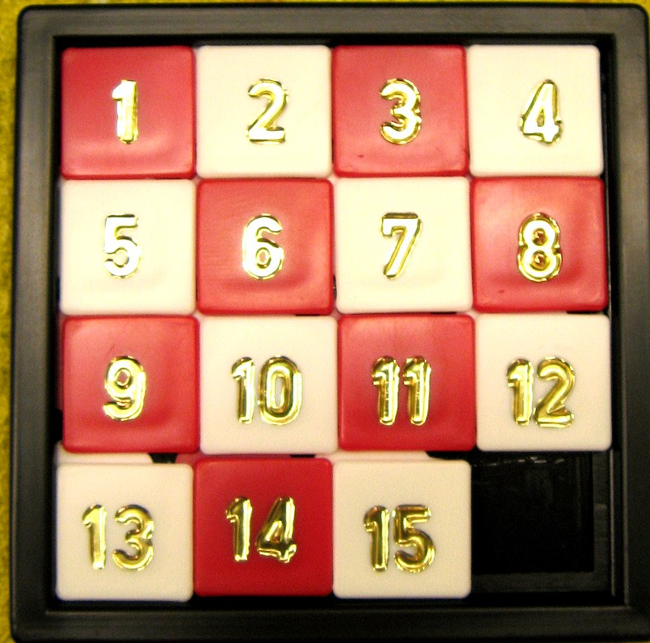
History
The first version of puzzle was invented by Noyes Palmer Chapman, a postmaster in Canastota, New York, 1874.
Copies of the improved Fifteen Puzzle made their way to Syracuse, New York, by way of Noyes' son, Frank.
From NY to Watch Hill, Rhode Island, and finally to Hartford.
American School for the Deaf started manufacturing the puzzle and selling them by December 1879.

Slide 3
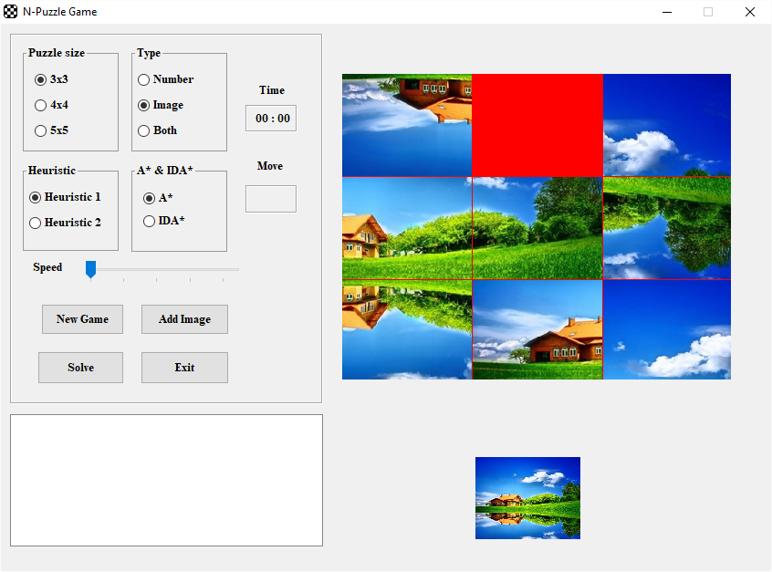
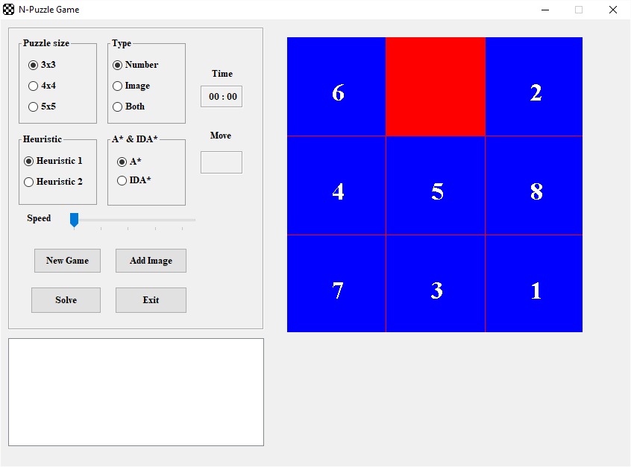
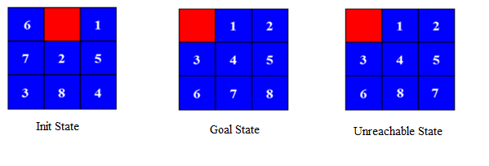
User Interface

Slide 4
A*
A* algorithm is a best-first search algorithm in which the cost linked to a state is f(n) = g(n) + h(n),where
g(n) is the cost of the path traversed from the initial state to node n.
h(n) is the estimated path-cost or the heuristic function cost from node n to the goal node.
The primary drawback of A* algorithm as in case of most best-first search is its space requirement

Slide 5
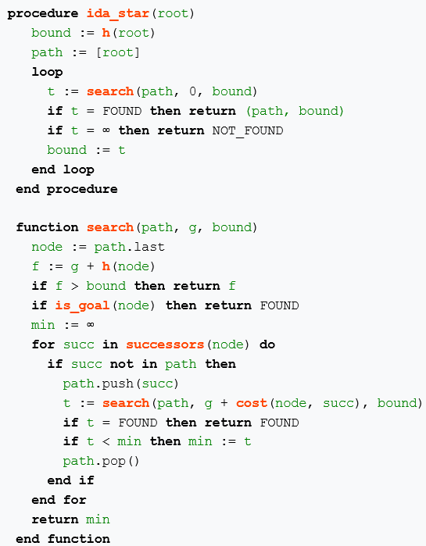
IDA*
Iterative-deepening-A* : at each iteration, perform a depth-first search, cutting off a branch when its total cost f(n)=g(n)+h(n) exceeds a given threshold.
This threshold starts at the estimate of the cost at the initial state, and increases for each iteration of the algorithm.
At each iteration, the threshold used for the next iteration is the minimum cost of all values that exceeded the current threshold.

Slide 6
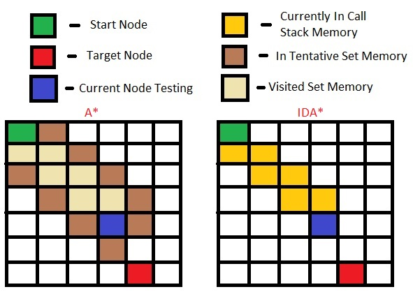
A* vs IDA*
A* search keeps a large queue of unexplored nodes that can quickly fill up memory.
IDA* does not remember any node except the ones on the current path, it requires an amount of memory that is only linear in the length of the solution that it constructs.

Slide 7
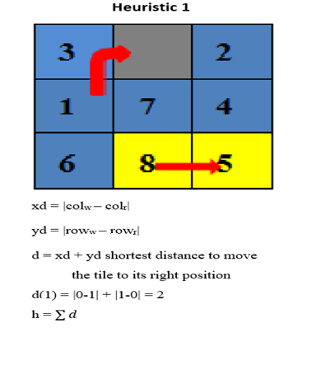
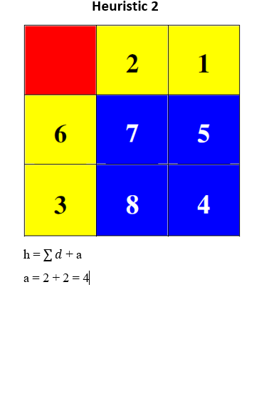
Heuristics

Slide 8
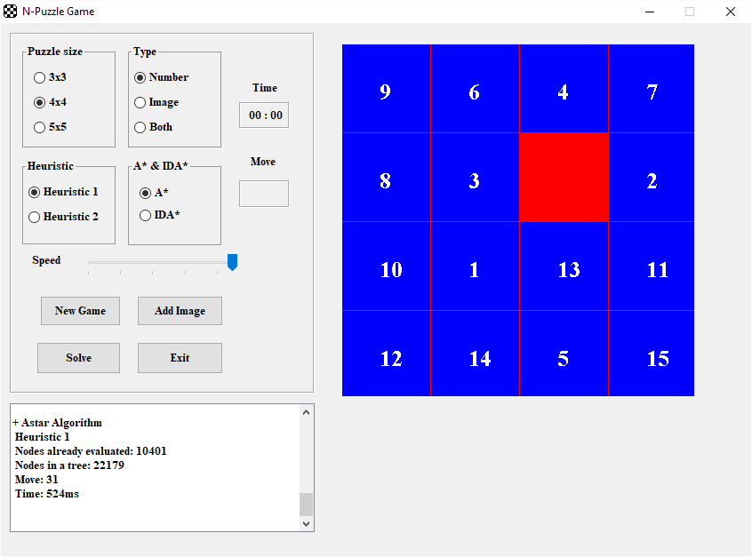

Compare A*

Slide 9


Compare IDA*

Slide 10
References
1. Bhasin, Harsh, and Neha Singia. “Genetic Based Algorithm for N –Puzzle Problem.” Nternational Journal of Computer Applications (0975 –8887), Aug. 2012. International Journal of Computer Applications (0975 –8887)Volume 51–No.22, August 2012
2. Culberson, Joseph C, and Jonathan Schaeffer. “Efficiently Searching the 15-Puzzle.” The University of Alberta, May 1994. Technical Report TR 94,08 May 1994
3. Korf, Richard E, and Larry A Taylor. “Finding Optimal Solutions to the Twenty-Four Puzzle.” Computer Science Department, University of California, Los Angeles, 1996.
4. Johnson, Storey. “ Notes on the 15'-Puzzle”. Amer. J. Math. 2(1879), 397-404, 1987.
5. Alexander Reinefeld. “Complete Solution of the Eight-Puzzle and the Benefit of Node Ordering in I D A *.” Paderborn Center for Parallel Computing Waxburger Str. 100, D-33095 Paderborn, Germany, 1993

